Slide 1
File System Files Directories

Slide 2
Review
Memory Manager
coordinate how the different types of memory are used
keep track memory to allocate and release areas of main memory to processes
manage swapping between main memory and disk
No Memory Abstractions
Single program
One OS, only one process
Special register is used to protection between OS and process
Disadvantages: slow
Multiple program
One OS, many processes locate in memory
Divided into fixed size block
Disadvantages
Internal fragmentations
Two programs both reference absolute physical memory → static relocation

Slide 3
Review
Memory Abstractions
Multiple processes locate in memory (both primary and secondary)
Base and Limit Registers
Multiple processes locate in memory and protection
Base contains the first address of process in memory, Limit contains the length of process, the process owns private address space
Disadvantages
External fragmentation (Defragment)
Slow
Swapping
Multiple processes with ready processes locate in memory and passive processes locate in HDD – swap file area
Swap out/ in operator
Disadvantages
External fragmentation
Process can not grow in memory and the swap area on the disk is full → data segment upward, stack segment downward

Slide 4
Review
Memory Abstractions
Memory Management with Bitmaps
The memory divides units with same size that has a bit corresponding bit in the bitmap (0: free, 1: occupied)
Disadvantages
Slow when searching the bitmap to find a run of k consecutive 0 bits in the map (small)
External fragment (large size)
Memory Management with Linked Lists
Maintain a linked list of allocated (P) and free memory (H)
Allocating algorithms
First, Next, Best, Worst, Quick Fit
Virtual Memory
Software/ Process sizes larger than memory
Overlays
Developer splits program to many overlays
Disadvantages: developer‘s knowledge is important

Slide 5
Review
Memory Abstractions
Virtual Memory
Paging
Address space is broken up into pages
Physical memory is divided up into page frames
Virtual address vs. Physical address, manage address space with bit
MMU transfers Virtual address → p, d; then it looks up page table following the index to get the page frame; the page frame combines with d to determine the physical address
Page fault: the program references a part of its address space that is not in physical memory
Page table
Load to collection registers, load to memory using base register, using TLB
Excessive large page table: multilevel page, inverted page table, inverted page table with hash or TLB
Entry: Caching disabled, Referenced, Modified, Protection, Present/absent, page frame number

Slide 6
Review
Memory Abstractions
Virtual Memory
Paging
Page replace algorithms
Optimal: the page will be the latest one accessed in the future
NRU: the page has lowest class that combines R and M bit
FIFO: the page at the head of queue
Second Chance: old page has not been not referenced in the previous clock interval (R = 0). If R of page equals 1, R is reset to 0 and put the tail of the queue.
Clock (circular queue) : the page being pointed to by the hand is inspected. If R = 0, page is evicted. Otherwise, R is reset to 0, the pointer points next
LRU: the page at the end of the list is replaced, the list must be updated at each memory reference
NFU, Aging (using bit): The page with the lowest counter
Working set model, working set clock (circular queue): Third Chance with Second Chance using age > τ with bit R
Terminology: Thrashing, Locality of Reference, Demand paging, prepaging, working set, page fault rate

Slide 7
Review
Design Issues
Local vs Global Policies
Local: page frames are static allocated among current processes (thrashing or waste memory)
Global: page frames are dynamically allocated among runnable processes (thrashing to others process)
Solution
Monitor the size of working set of all processes using aging bit
The allocation is updated dynamically using PFF algorithms with To periodically determine the number of running processes, Giving each process a minimum number of frames
Load Control
Swapping and Considering not only process size and paging rate but also its characteristics
Page Size
Optimizing the size of the page and the location of page table

Slide 8
Review
Design Issues
Separate Instruction and Data Spaces
Sharing code, library, read only memory
Copy on write
Memory Mapped File
Paging the file as process
Cleaning Policy
Using two-handed clock
Front hand is controlled by the paging daemon
Back hand is used for page replacement algorithm as in the standard clock algorithm
Implementation Issues
Instruction Backup
A hidden internal is used to store the PC before each instruction is executed
A second register is used to store the registers auto-incremented or auto-decremented, and by how much
When the fault instruction is restarted, the OS can unambiguously undo all the effects of it

Slide 9
Review
Implementation Issues
Locking Pages in Memory
Lock pages engaged in I/O in memory so that they will not be removed
Do all I/O to kernel buffers & copy the data to use pages later
Backing Store
Associated with each process is the disk address of its swap area, that is where on the swap partition its image is kept (that also kept in process table)
Paging to a static swap area vs. Backing up pages dynamically
Segmentation
Is a logical entity and Consists of a linear sequence addresses, from 0 to some maximum that can grow and shrink independently without effecting each other
To specify an address in the segmented memory, the <segment-number, offset> is used
Implementing
Segment table
Segmentation with Paging

Slide 10
Objectives
Files
File Naming
File Structure
File Types
File Access
File Attributes
File Operations
An Example Program using File System Calls
Directories
Single-Level Directories Systems
Hierarchical Directory Systems
Path Names
Directory Operations

Slide 11
Overview
Problems
While a process is running, it can store a limited amount of information within its own address space. However, the storage capacity is restricted to the size of the virtual address space
The information is lost when the process terminates
It is frequently necessary for multiple processes to access (parts of) the information at the same time
There are 3 essential requirements for long-term information storage
It must be possible to store a very large amount of information
The information must be survive the termination of process using it
Multiple processes must be able to access the information concurrently
Disk and its 2 operation (read, write) are used to solve the long-term storage problem

Slide 12
Files
Definition
Are the abstraction (objects and mechanism), that models in a convenient way the information stored and read it back on hardware devices and are managed by OS
Are logical units of information (created by processes)
Processes can read existing files&create new ones if need be
Information stored in files must be persistent (not be affected by process creation and termination)
File system
The OS’s component that manages the information stored on the storage devices and provides the users access to that information in a convenient way
Hides the complexity of storage hardware devices
Provides the users a uniform logical view of the information stored on these devices, based on the concept of file
Maps files onto physical devices

Slide 13
Files
Naming
When a process creates a file, it gives the file a name.
When the process terminates, the file continues to exist and can be accessed by other process using its name
File name = string of characters giới hạn độ dài < 25 kí tự
The exact rules for file naming vary somewhat from system to system
Distinction between upper and lower letters
Limit of name length <25 kí tự
Extension (optional)
Provides some information about the file’s content structure
Is used to register with OS and specify for each program owns that extension
Ex: hello.c; hello.bat, hello.txt

Slide 14
Files
Structure
There are 3 common way possibilities
An unstructured sequence of bytes
Byte sequences (maximum flexibility)
Can put any thing they want and name file any way
Record sequence
A file is a sequence of fixed length record, each with some internal structure
Provides read, write, and append operation
Tree
A file consists of a tree of records, not necessarily all the same length, each containing a key field in a fixed position in the record
The tree is sorted on sắp xếp the key field, to allow rapid searching for a particular key
Provides the get operation to get the record with specifies key
OS decides the new record’s position

Slide 15
Files
Structure
Tanenbaum, Fig. 4-2.

Slide 16
Files
Types
OS supports several types of files
Regular files
Contain user data information (ASCII or binary)
Directories
System files for maintaining the structure of the file system
Character Special files
Are related of I/O ad used to model serial I/O devices
Ex: terminals, printer, networks
Block Special files
Disks Model

Slide 17
Files
Access
Sequential access
Reads the bytes or records in order, starting at the beginning, but could not skip around and read them out of order
Could be rewound
Specific to magnetic tapes
Operation: read
Random access
Reads the bytes or records out of order, or to access records by key rather than by position
Specific to disks
Operation: seek

Slide 18
Files
Attributes
The extra information is associated to file by OS
Is also called metadata
Some attributes
Type
Length
Time stamps
creation time, time of last access, time of last modification
Owner
Access rights
read (view), write (modify), execute, delete
Different flags
hidden, system, locked etc.
…..

Slide 19
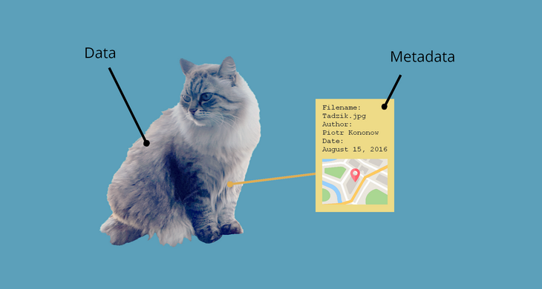
Metadata is defined as the data providing information about one or more aspects of the data; it is used to summarize basic information about data that can make tracking and working with specific data easier. Some examples include: Means of creation of the data. Purpose of the data. Time and date of creation.

Slide 20
Files
Operations
Create
Delete
Open
Close
Read
Write
Seek
Get attributes
Set attributes
Rename

Slide 21
Files
An Example Program Using System Calls
Tanenbaum, Fig. 4-5.

Slide 22
Files
An Example Program Using System Calls
Tanenbaum, Fig. 4-5.

Slide 23
Directories Definition
A way of organizing files
Impose a hierarchy of files
Consists of a collection of files and subdirectories
Can be viewed as a special file managed by the OS

Slide 24
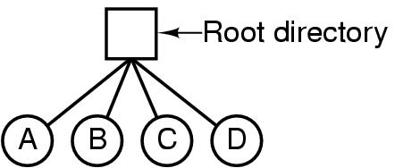
Directories/ Folders
Single-Level Directory Systems
Is having one directory containing all files (root directory)
Applying on system that can be used by only one or many users
Is adequate for simple dedicated applications
Advantages
Simplicity
The ability to locate file quickly
Disadvantages
The file name can be duplicated in one/ many users
Tên tập có thể nhân đôi cho nhiều người dùng
Tanenbaum, Fig. 4-6.

Slide 25
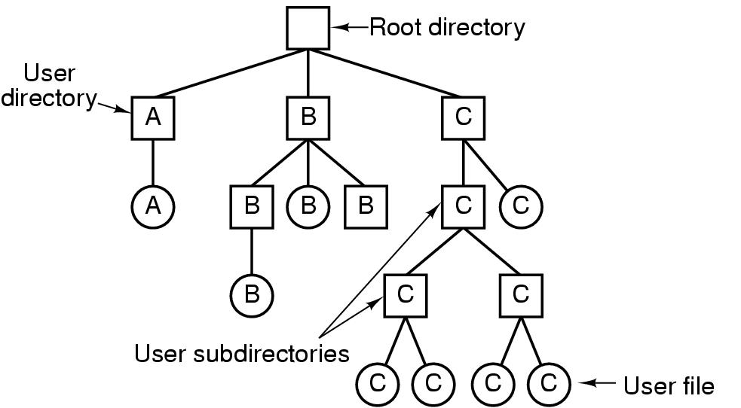
Directories/ Folders Hierarchical Directory Systems
Single-Level
Hierarchical
It would be impossible to find anything if all files were in a single directory (slow) → group related files together
There can be as many directories as are needed group the files in natural ways
If multiple users share a common file server, as is the case many computer networks, each user can have a private root directory for his or her own hierarchy
The ability for users to create an arbitrary number of subdirectories provides a powerful structuring tool for users to organize their work
Tanenbaum, Fig. 4-7.

Slide 26
Directories/ Folders Path Names
Absolute path name
Starts from the root directory to the file
Ex
/home/students/john/program.c (in Linux)
C:\Program Files\Application\run.exe (in Windows)
Relative path name
Starts from the current (working) directory that can be owned to users
Each application has its own working directory
Ex
john/program.c (in Linux)
application\run.exe (in Windows)
Special directories in relative paths
current directory: .
parent directory: ..

Slide 27
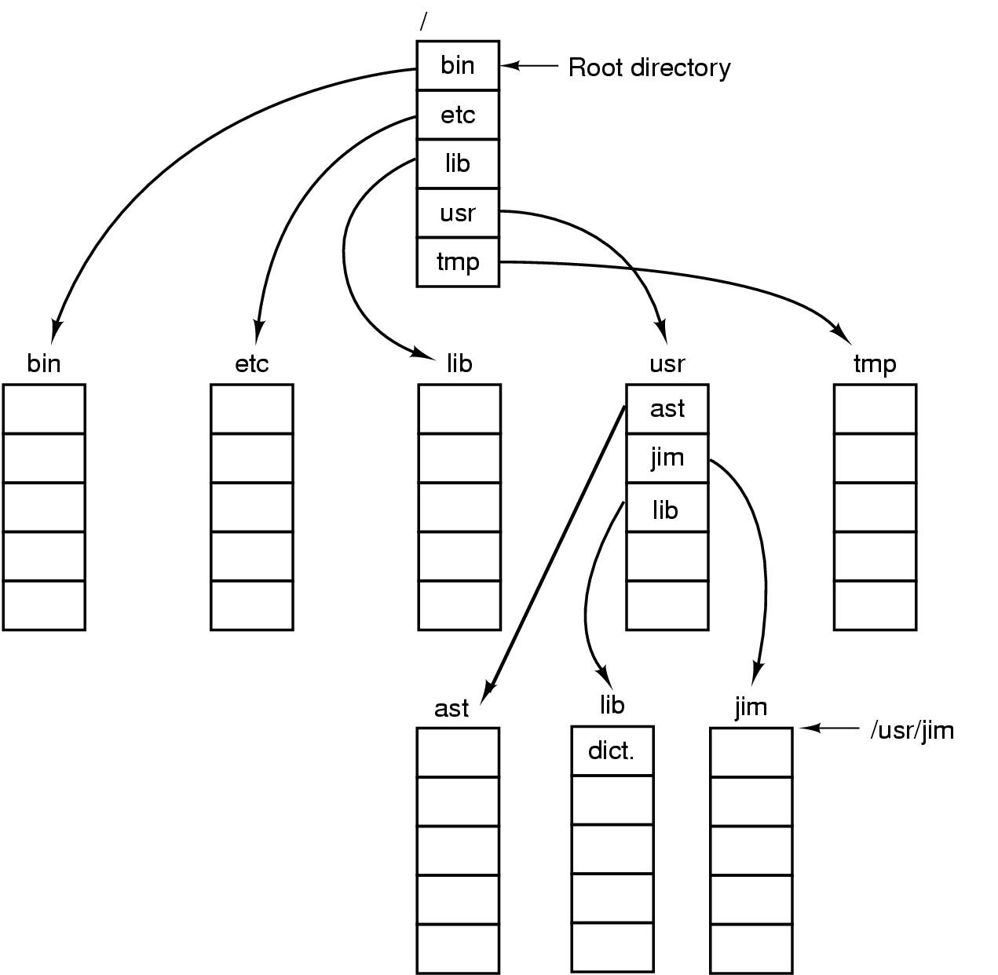
Directories/ Folders Path Names
Tanenbaum, Fig. 4-8.

Slide 28
Directories/ Folders Operations
Create
Delete
Opendir
Closedir
Readdir
Rename
Link: Allow a file to appear in more than one directory
Unlink

Slide 29
Summary
Operating System Concepts
Files
Directories
Q&A

Slide 30
Next Lecture
File System Implementation

